Slide 1
Databases Design. Introduction to SQL LECTURE 11 Nested queries
IITU, ALMATY, 2020

Slide 2
Link to the Video
https://youtu.be/byInBhICUtQ

Slide 3
The Complete Select Statement
SELECT attribute(s)
FROM table(s)
[WHERE selection condition(s)]
[GROUP BY condition]
[HAVING selection condition]
[ORDER BY condition]

Slide 4
Nested Queries
Nested query (Subquery or Inner query) is a query within another SQL query.
Subquery is used to return data that will be used in the main query as a condition to further restrict the data to be retrieved.
Subqueries allow to express a selection condition using a tradition SELECT-FROM-WHERE statement.

Slide 5
Nested Queries
Subqueries can be used with the SELECT, INSERT, UPDATE, and DELETE statements along with the operators like =, <, >, >=, <=, IN, etc.
There are a few rules that subqueries must follow:
Subqueries must be enclosed within parentheses – (…).
Subqueries that return more than one row can only be used with multiple value operators such as the IN, ANY, ALL operators.

Slide 6
Nested Queries
Subqueries are most frequently used with the SELECT statement. For example, the basic syntax for using subquery in WHERE clause:
SELECT attribute(s)
FROM table(s)
WHERE attribute OPERATOR
(SELECT attribute(s)
FROM table(s)
[WHERE] );

Slide 7
Nested Queries
There are three types of subqueries: scalar, row, table. Scalar subquery returns a single column and a single row (a single value).
Example: Return the first and last name of the student who has group’s name = ‘CSSE-01‘.
SELECT fname, lname
FROM Students
WHERE group_id =
(SELECT group_id
FROM Groups
WHERE name=‘CSSE-01’);

Slide 8
Subqueries with comparison operators
Using of сomparison operators is possible only when a result of a subquery is one value (one field).
Operator | Description
< | less than
> | greater than
<= | less than or equal to
>= | greater than or equal to
= | equal
<> or != | not equal

Slide 9
Subqueries with comparison operators
SELECT fname, lname, gpa
FROM Students
WHERE gpa > (SELECT avg(gpa)
FROM Students);
-------------------------------------------------------------
SELECT fname, lname, gpa
FROM Students
WHERE
gpa > (SELECT avg(gpa) FROM Students)
AND
gpa < (SELECT max(gpa) FROM Students);

Slide 10
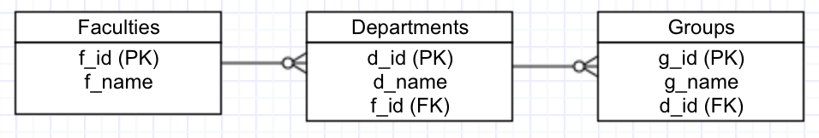
Subqueries with comparison operators
SELECT f_name
FROM Faculties
WHERE f_id = (
SELECT f_id
FROM Departments
WHERE d_id = (
SELECT d_id
FROM Groups
WHERE g_name = ‘CSSE - 01’));

Slide 11
Set Membership
The IN and NOT IN operators can be used to test simple set membership.
IN and NOT IN are typically used in subqueries in WHERE. For example,
WHERE … IN (SELECT …);
WHERE … NOT IN (SELECT …);

Slide 12
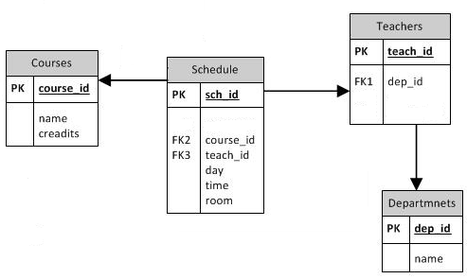
Set Membership: example
SELECT c.name
FROM Course c, Schedule s
WHERE c.course_id = s.course_id
AND s.teach_id IN (
SELECT t.teach_id
FROM Teachers t, Department d
WHERE t.dep_id=d.dep_id
AND d.name=‘CET’);

Slide 13
Another query with the identical result
SELECT c.name
FROM Courses c, Schedule s, Teachers t, Department d
WHERE c.course_id = s.course_id
AND s.teach_id = t.teach_id
AND t.dep_id=d.dep_id
AND d.name=‘CET’;

Slide 14
EXISTS and NOT EXISTS
SQL allows testing the emptiness of a subquery’s result using the EXISTS and NOT EXISTS keywords.
The EXISTS keyword tests if a result is not empty. NOT EXISTS tests if a result is empty.
If it returns at least one row, the result of EXISTS is "true"; if the subquery returns no rows, the result of EXISTS is "false".

Slide 15
EXISTS: example
SELECT fname, name
FROM Students
WHERE EXISTS (
SELECT *
FROM Students
WHERE group_id = 1);

Slide 16
ANY
… attribute OPERATOR ANY (subquery)
The ANY operator compares the value to each value returned by the subquery. Therefore ANY keyword (which must follow a comparison operator) returns TRUE if the comparison is TRUE for ANY of the values in the column that the subquery returns.
"IN" is equivalent to "= ANY".

Slide 17
ANY: example
SELECT *
FROM Students s
WHERE s.bdate < ANY (
SELECT t.bdate
FROM Teachers t);
20.03.1990 < (19.03.1988, 23.05.1993)
True

Slide 18
ALL
… attribute OPERATOR ALL (subquery)
The ALL operator compares value to every value returned by the subquery. The result of ALL is true if all rows yield true. The result is false if any false result is found.
"NOT IN" is equivalent to "<> ALL".

Slide 19
ALL: example
SELECT *
FROM Students s
WHERE s. bdate < ALL (
SELECT t.bdate
FROM Teachers t);
20.03.1990 < (19.03.1988, 23.05.1993)
False

Slide 20
Subquery in FROM (1)
A subquery can also be found in SELECT or FROM clauses.
SELECT num_of_stud
FROM (
SELECT group_id, count(*)
AS num_of_stud
FROM Students
GROUP BY group_id) StudNum;

Slide 21
HAVING vs Subquery
Example with HAVING from the last lecture:
SELECT group_id, count(*)
FROM Students
GROUP BY group_id
HAVING count(*) > 20;
The same result with subquery:
SELECT *
FROM ( SELECT group_id, count(*) AS num_of_stud
FROM Students
GROUP BY group_id) StudNum
WHERE num_of_stud > 20;

Slide 22
Subqueries in FROM (2)
SELECT *
FROM
(SELECT count(*) FROM students) students,
(SELECT count(*) FROM teachers) teachers;
count | count
… | ….

Slide 23
Subquery in INSERT (1)
Subqueries also can be used with INSERT statements. The INSERT statement uses the data returned from the subquery to insert into another table.
Example:
INSERT INTO Teachers (fname, lname)
(SELECT fname, lname
FROM Students
WHERE stud_id = 01);

Slide 24
Subquery in INSERT (2)
INSERT INTO Teachers (teach_id, fname, lname, dep_id)
VALUES (1, ‘…’,’…’,
(SELECT dep_id
FROM Departments
WHERE dep_name=‘CET’));

Slide 25
Subquery in DELETE
The subquery can be used in conjunction with the DELETE statement.
DELETE
FROM Students
WHERE group_id =
(SELECT group_id
FROM Groups
WHERE name=‘CSSE-01’);

Slide 26
Subquery in UPDATE
The subquery can be used in conjunction with the UPDATE statement. Either single or multiple columns in a table can be updated when using a subquery with the UPDATE statement.
UPDATE Students
SET group_id=group_id + 1
WHERE group_id =
(SELECT group_id
FROM Groups
WHERE name = ‘CSSE-01’);

Slide 27
Books
Connolly, Thomas M. Database Systems: A Practical Approach to Design, Implementation, and Management / Thomas M. Connolly, Carolyn E. Begg.- United States of America: Pearson Education
Garcia-Molina, H. Database system: The Complete Book / Hector Garcia-Molina.- United States of America: Pearson Prentice Hall
Sharma, N. Database Fundamentals: A book for the community by the community / Neeraj Sharma, Liviu Perniu.- Canada
www.postgresql.org/docs/manuals/
www.postgresql.org/docs/books/

